Slide 1
CHAPTER THREE Introduction to IP addressing & sub netting
IP addressing is the process of assigning a unique identifier to each device connected to a network.
This identifier, known as an IP address, allows devices to communicate with each other over the internet or a local network.
_{IPV4}
Address Space: Approximately 2³² 4.3 billion unique addresses.
Limitation: The rapid growth of devices has led to IPv4 address exhaustion.
IPV6
With 128 bits available for the host portion, each subnet can theoretically support:
2¹²⁸ unique addresses, which equals approximately 340 undecillion(36 zeros) addresses.
This structure allows IPv6 to accommodate a vast number of devices and networks compared to IPv4.

Slide 2
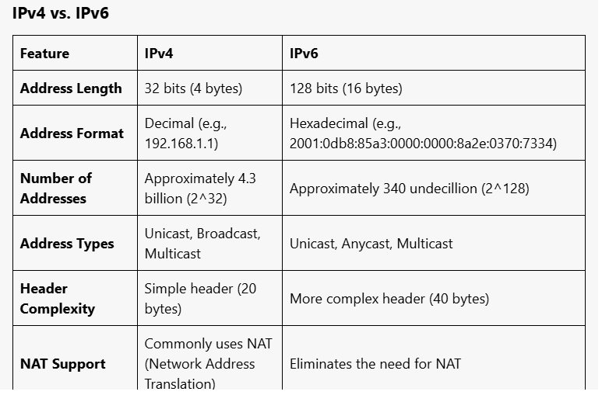

Slide 3
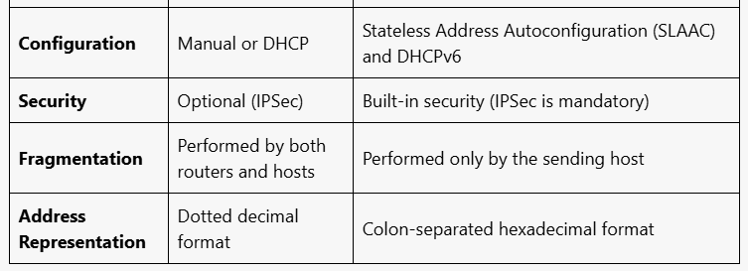

Slide 4
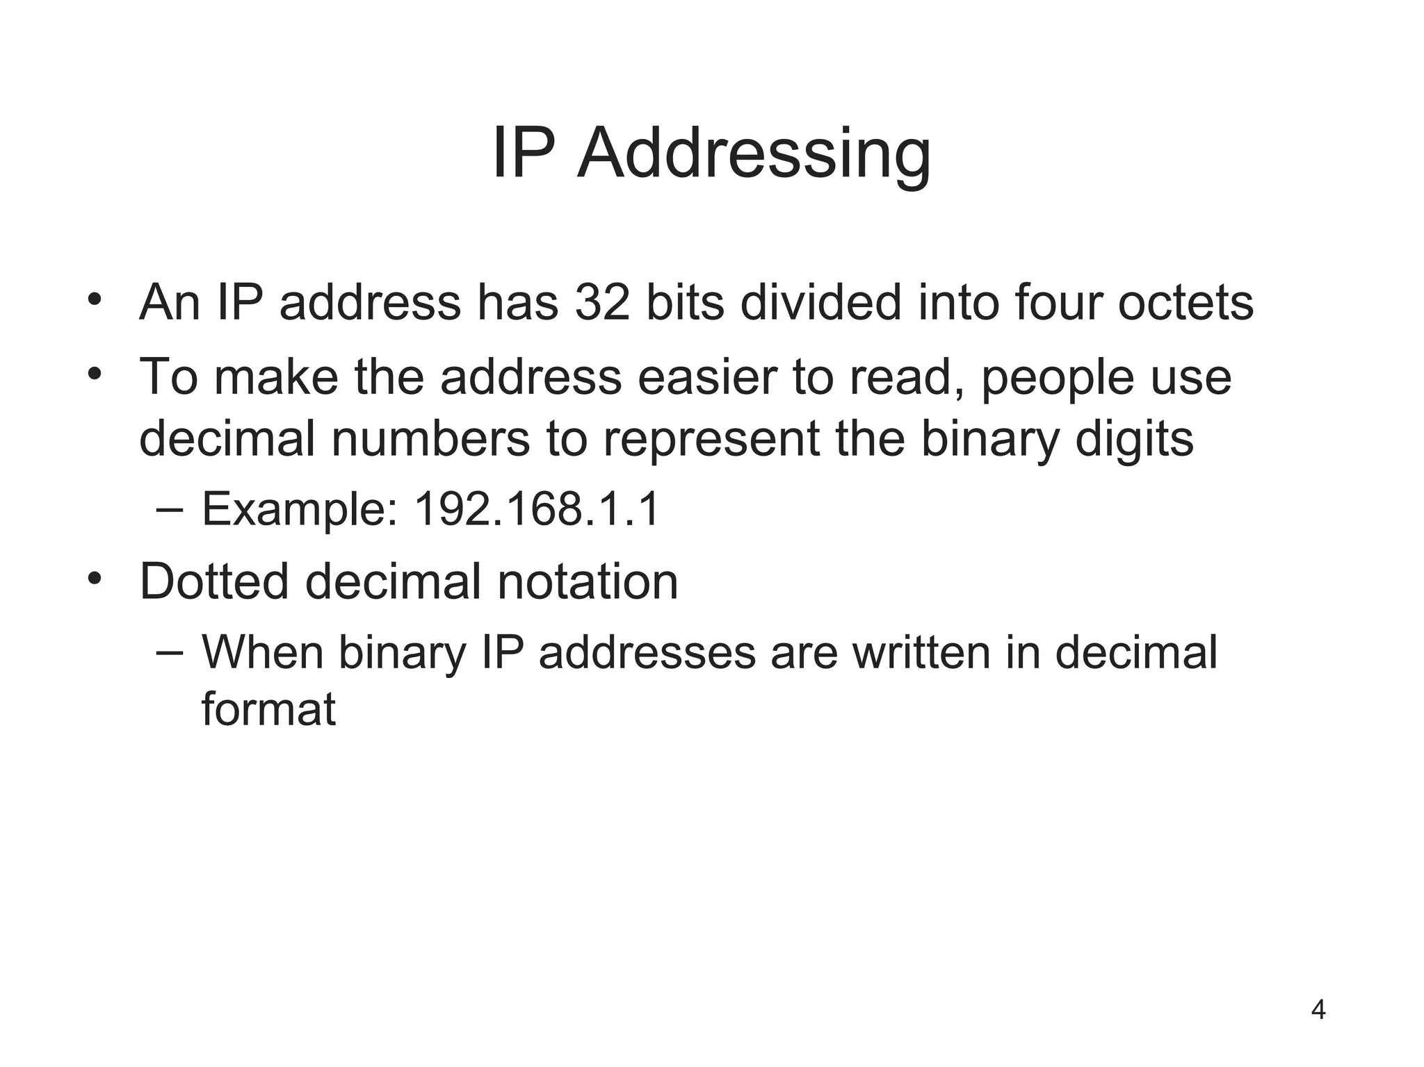

Slide 5
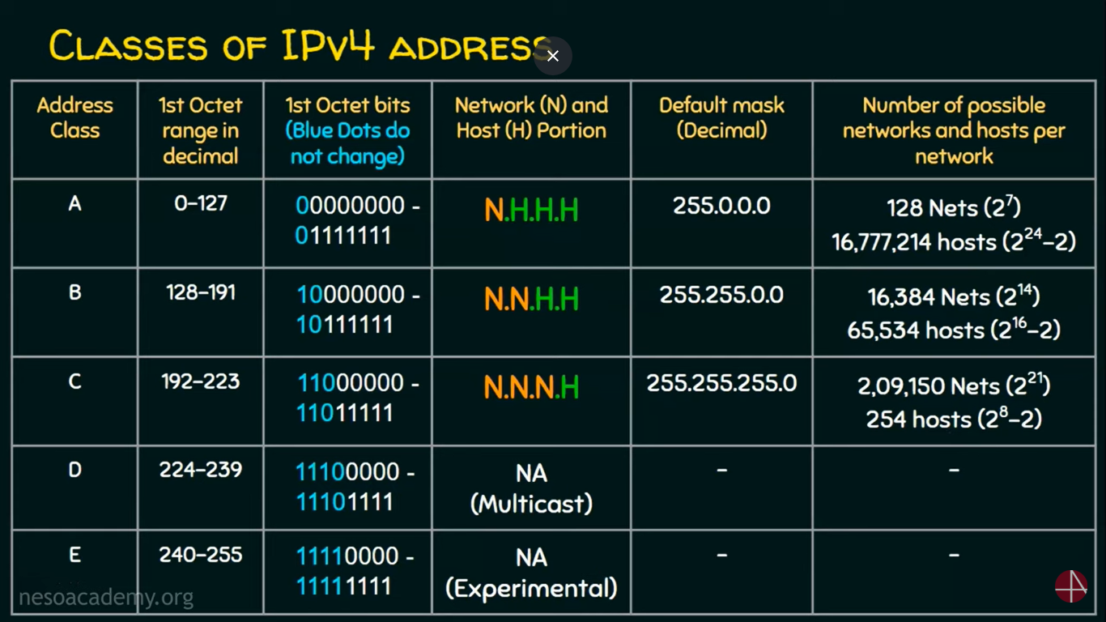

Slide 6
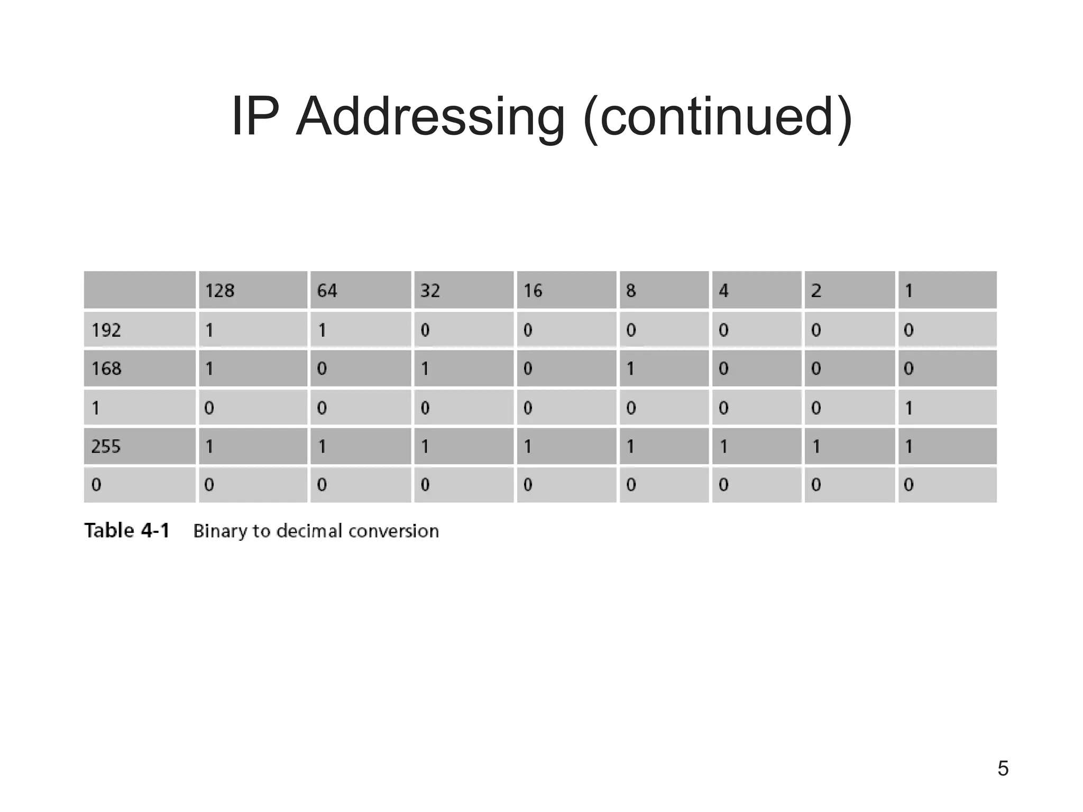

Slide 7
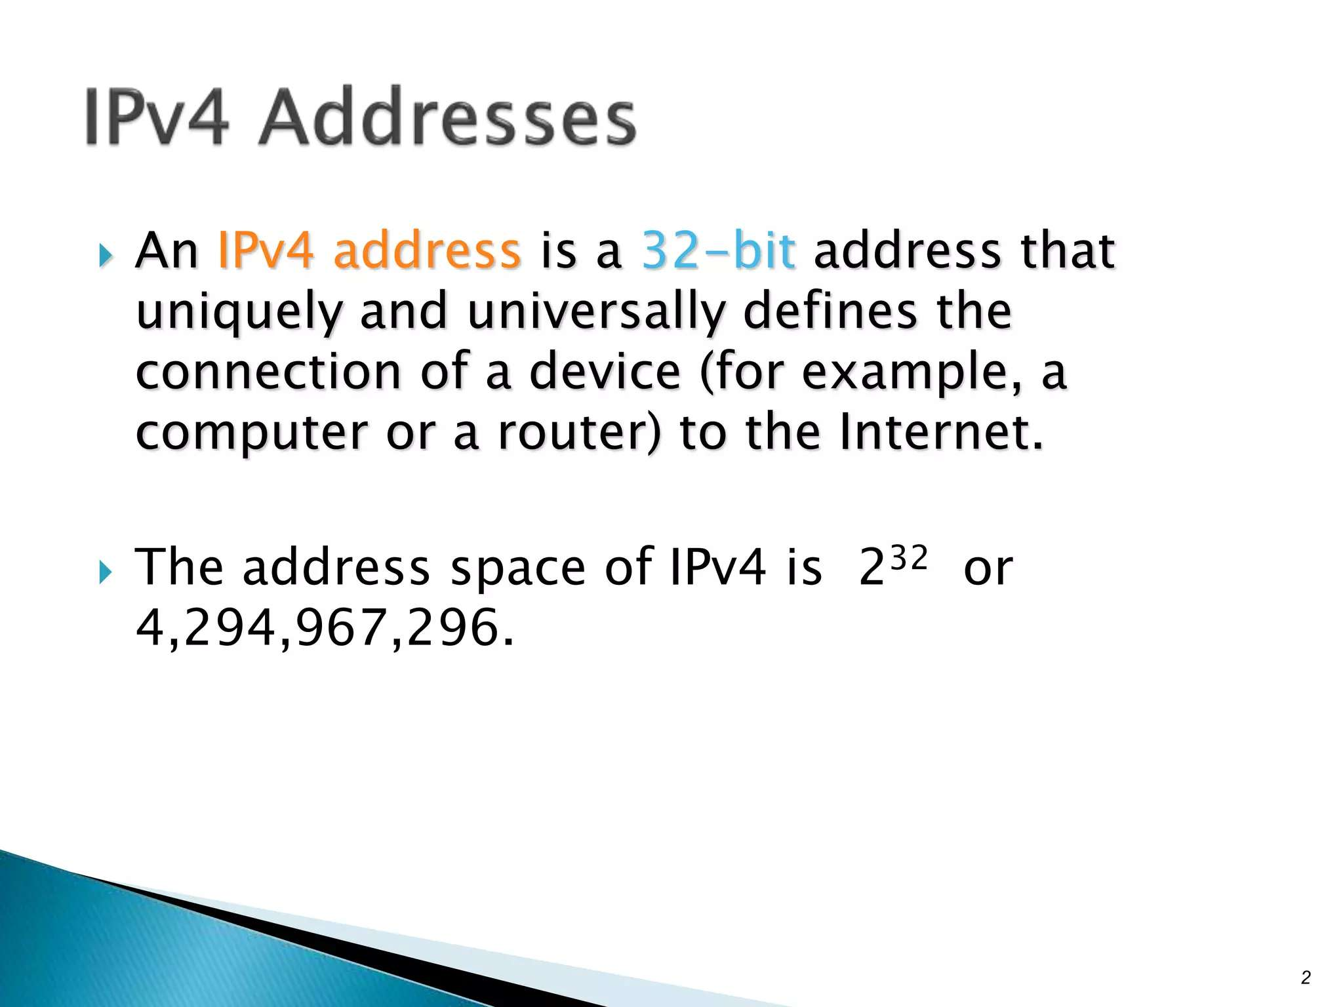

Slide 8
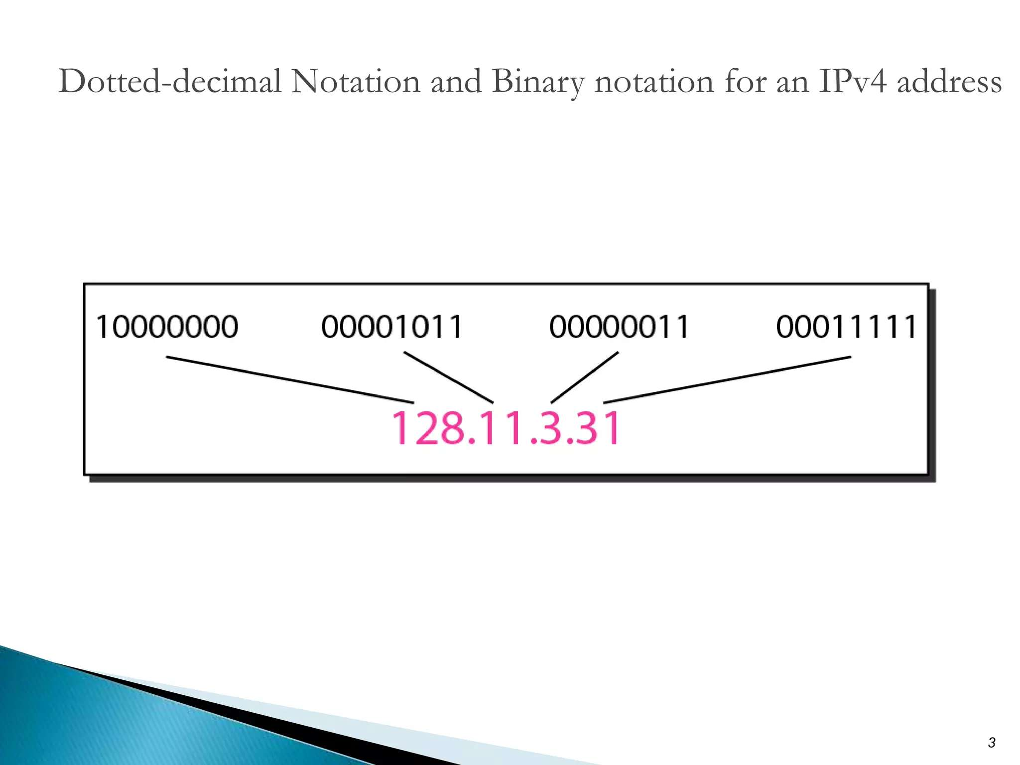

Slide 9
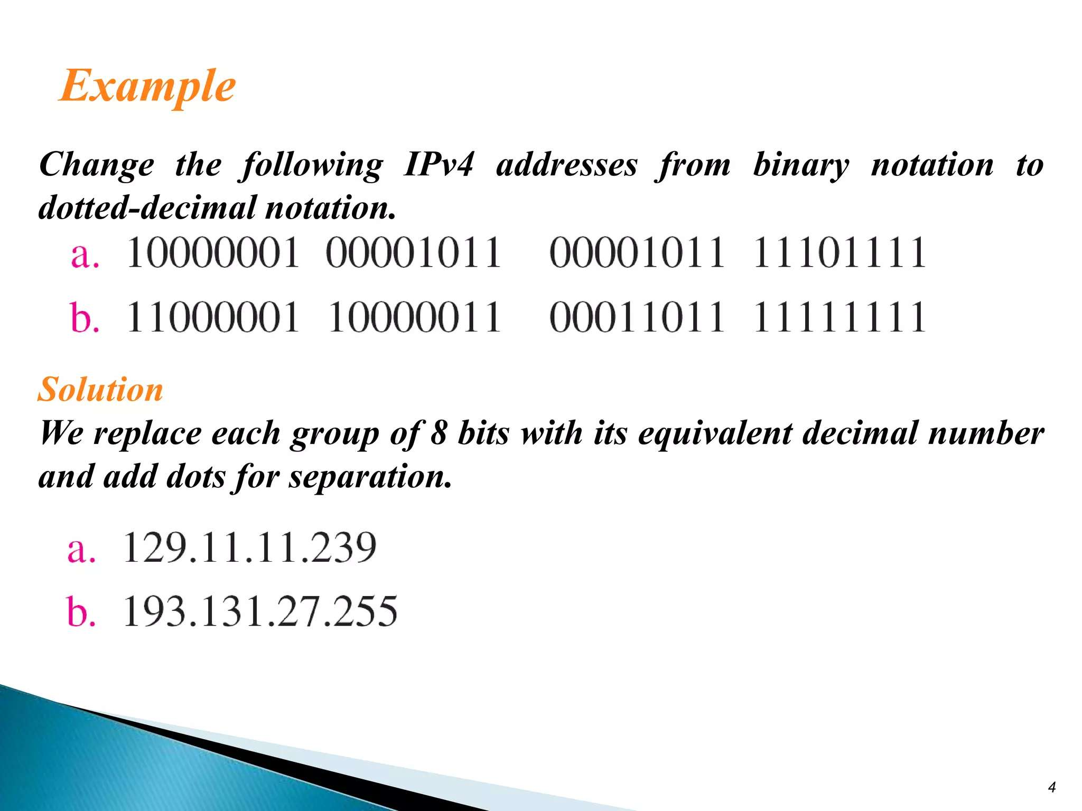

Slide 10
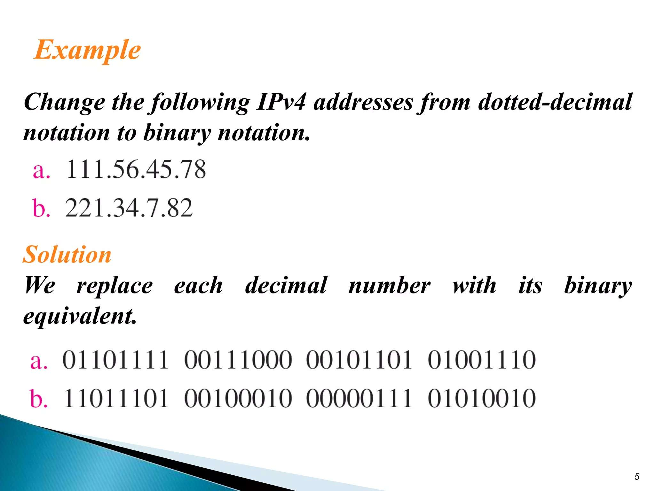

Slide 11
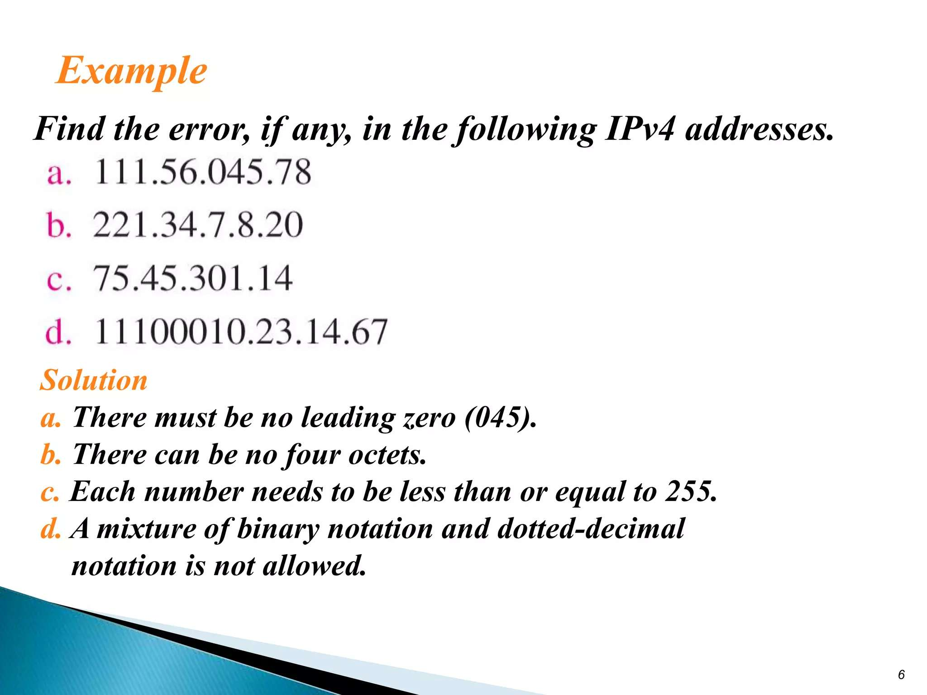

Slide 12
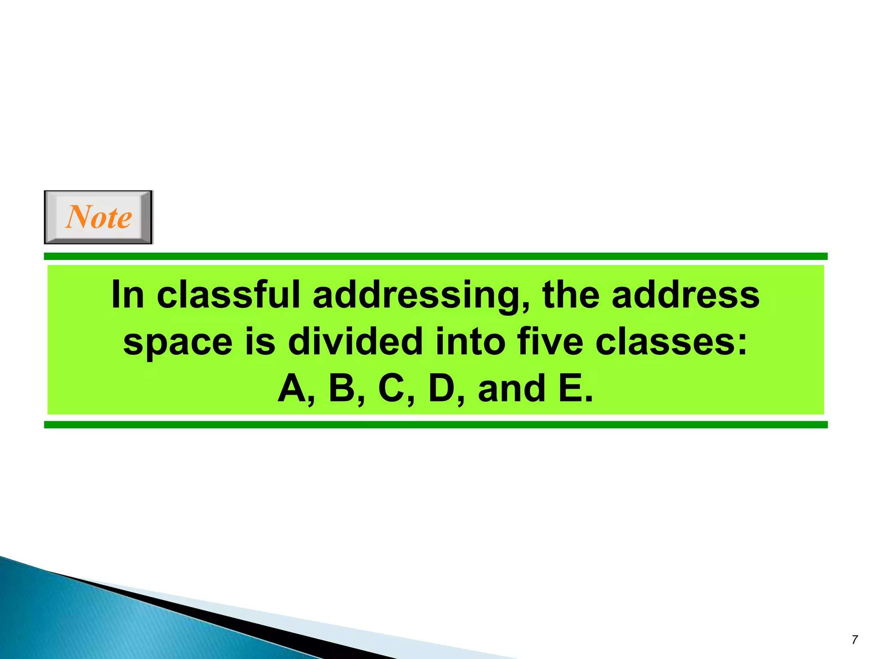

Slide 13
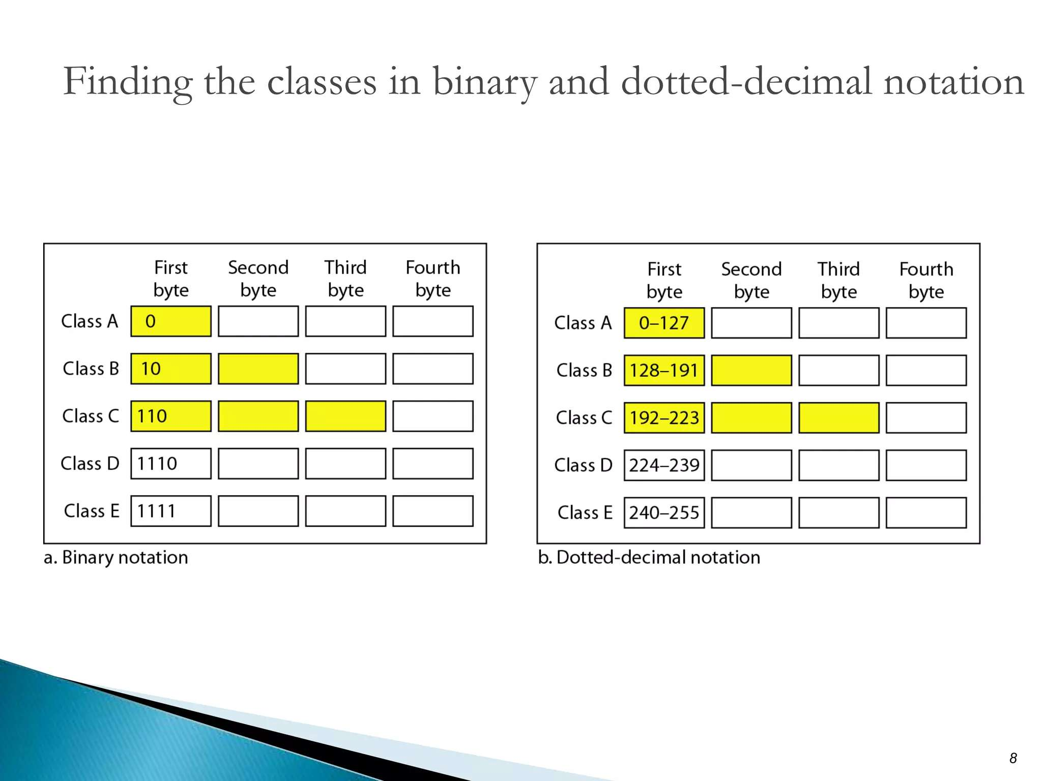

Slide 14
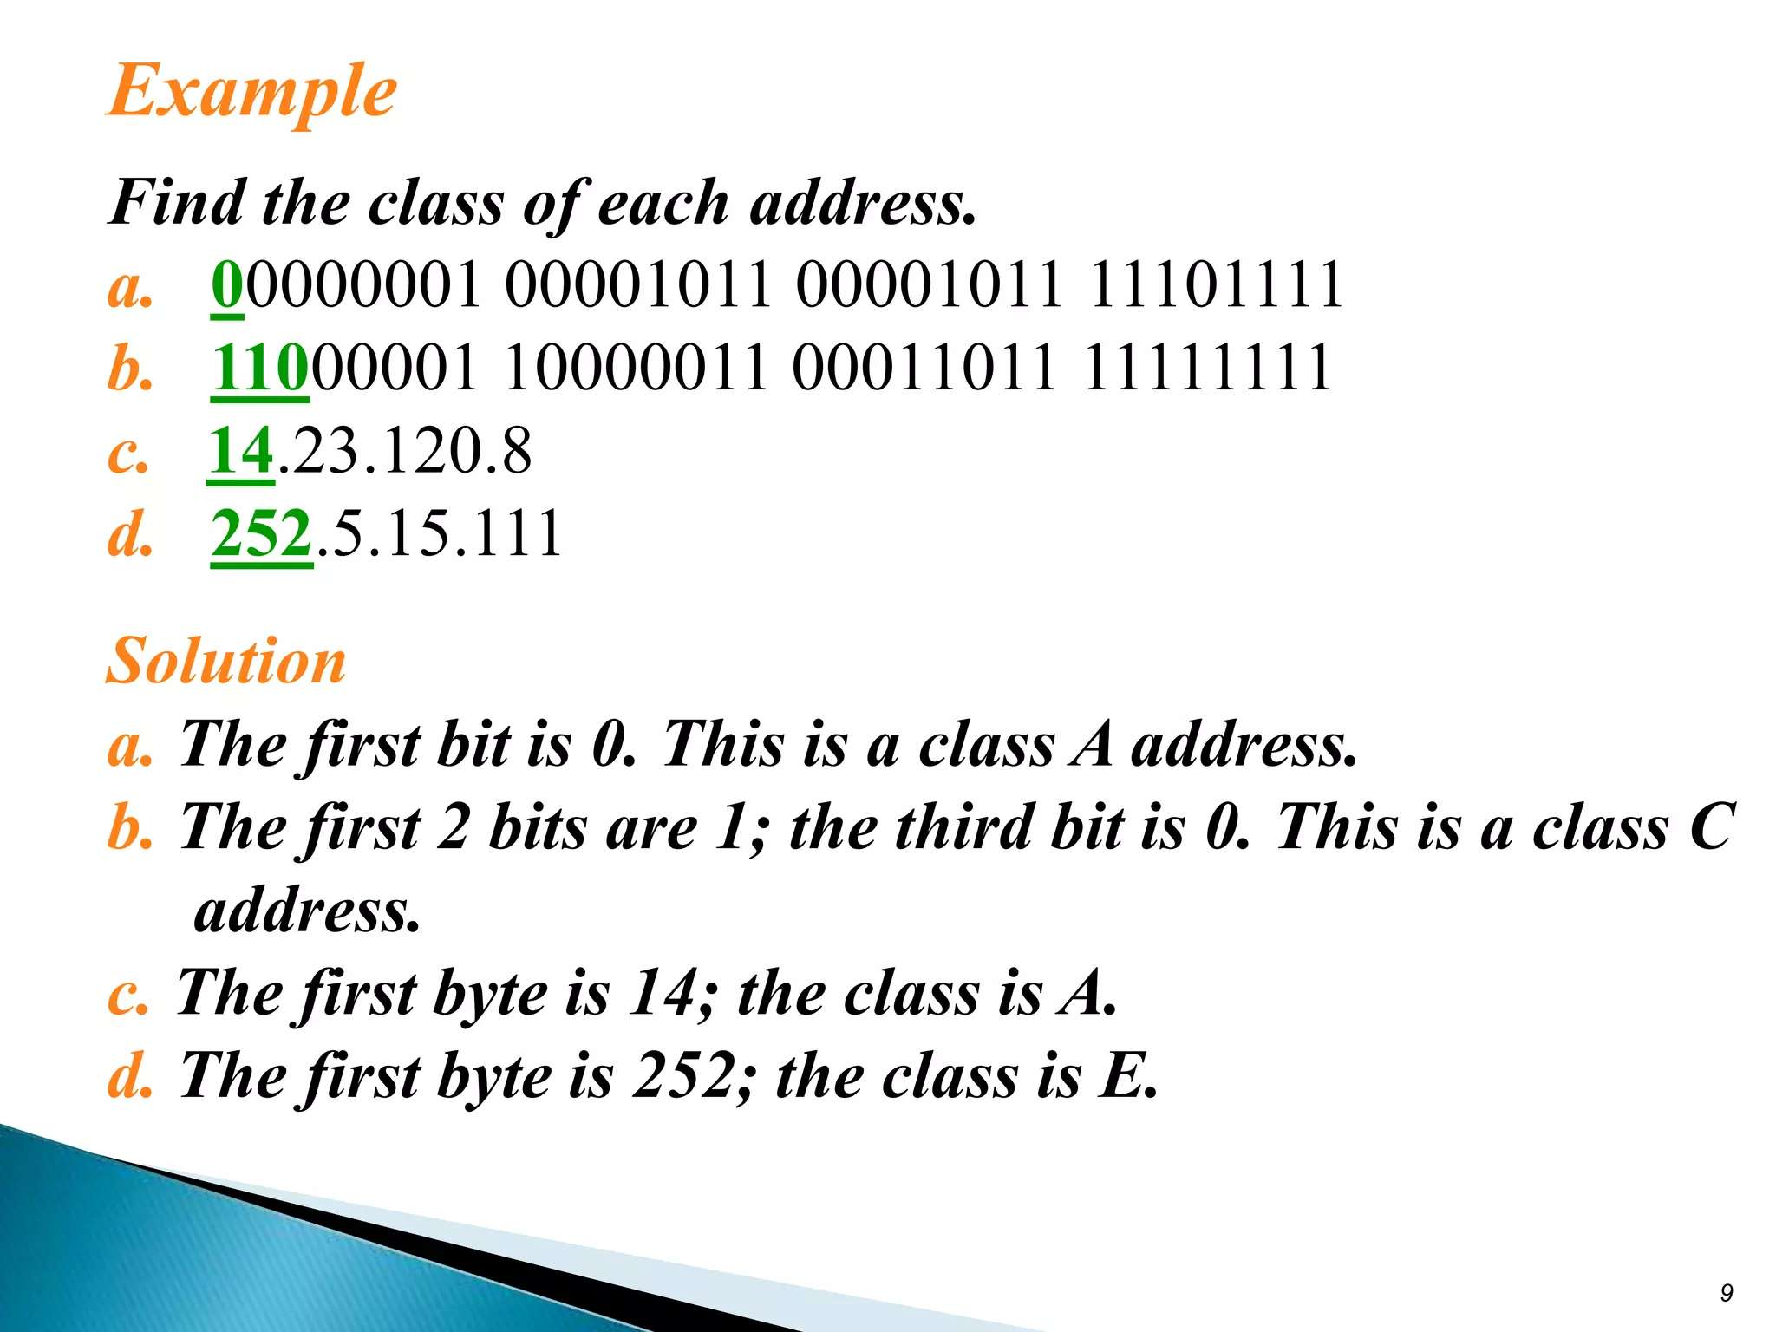

Slide 15
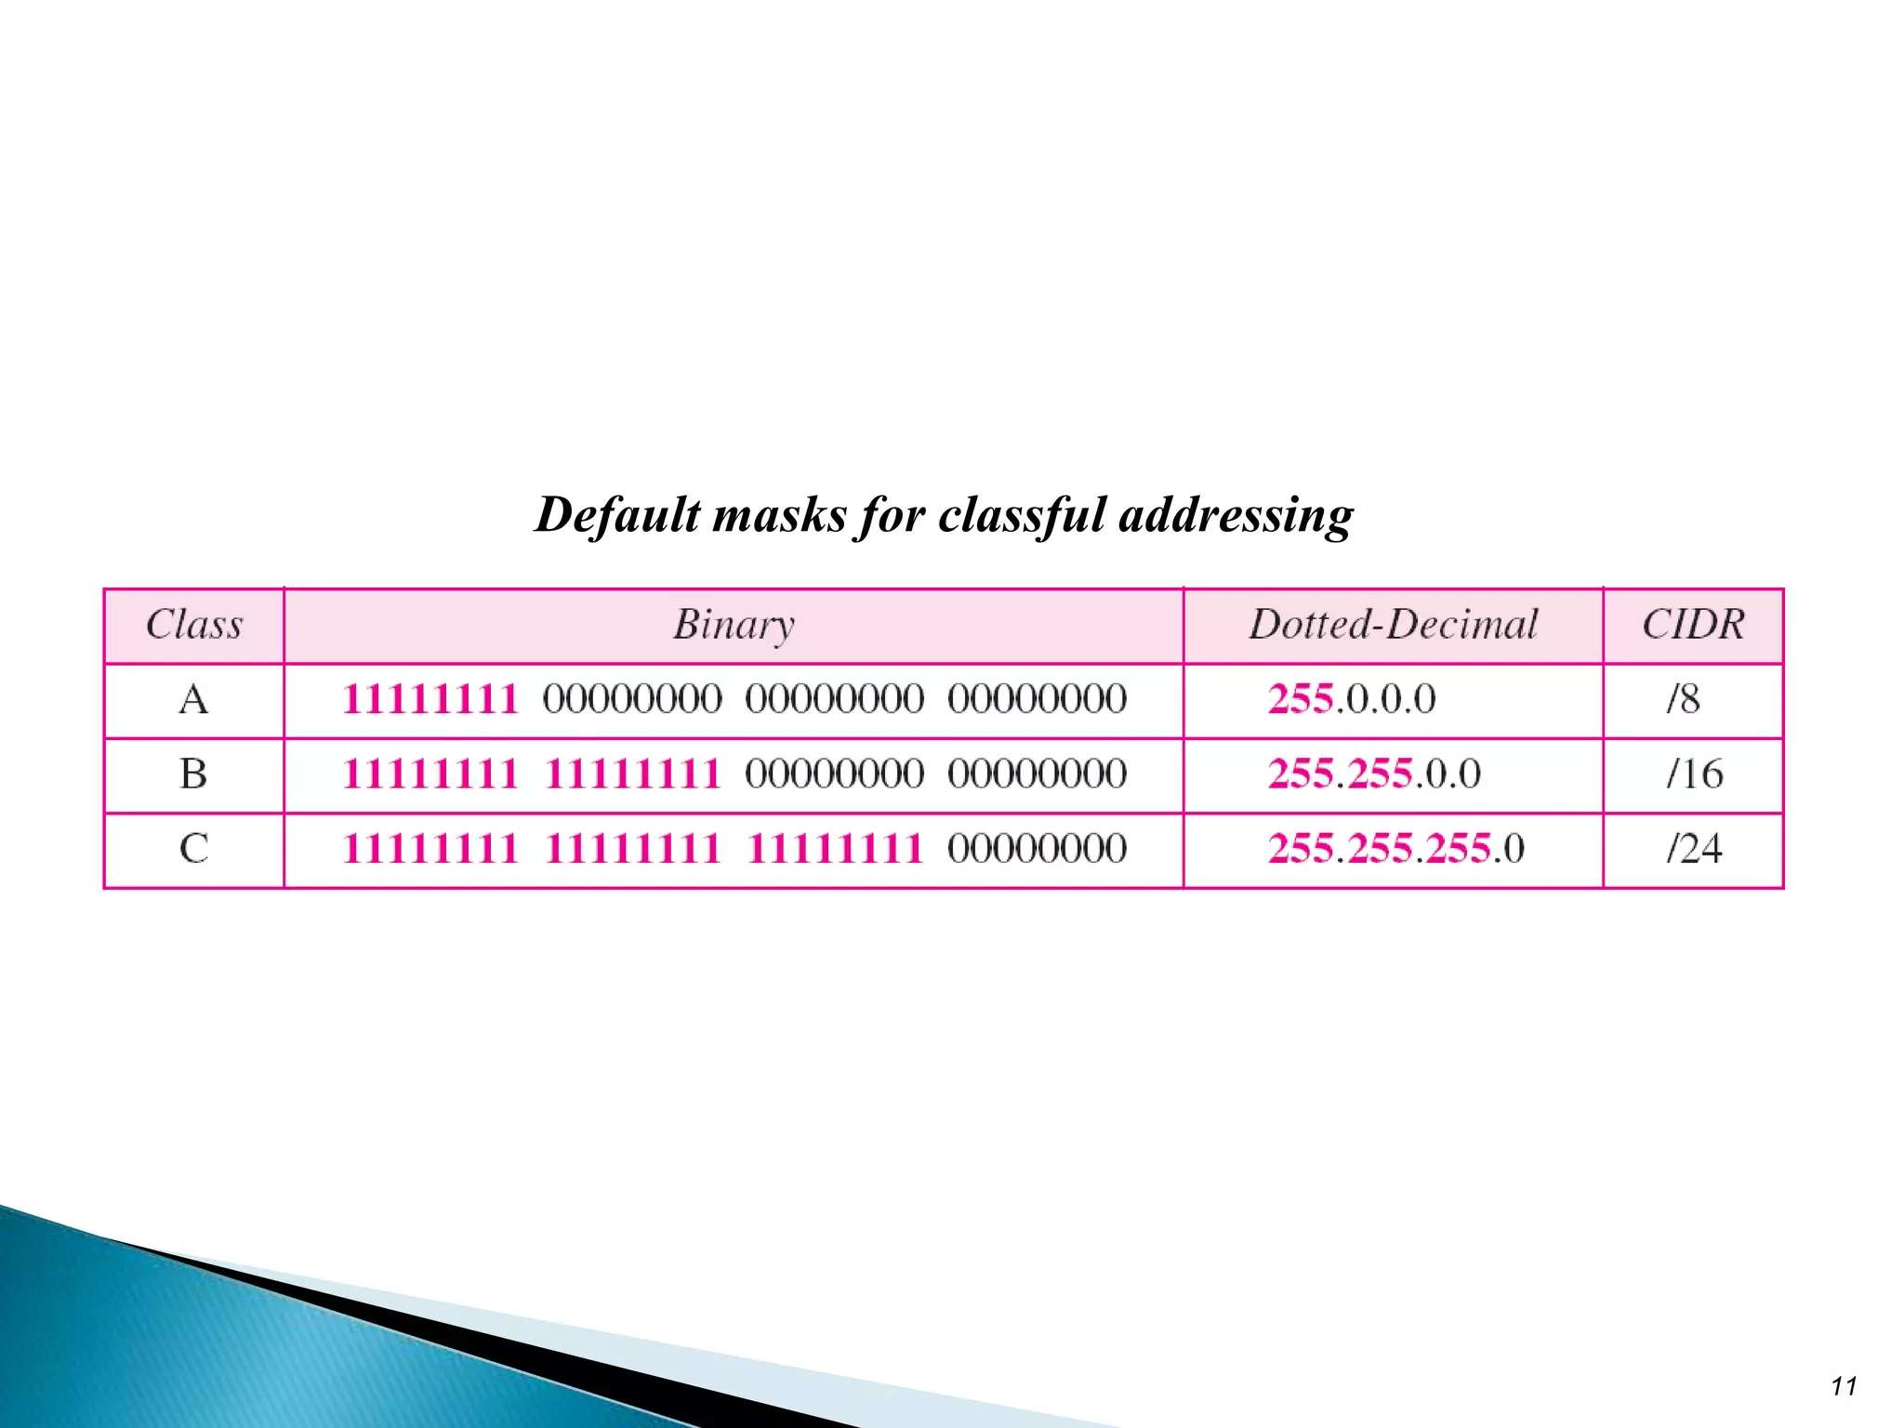

Slide 16
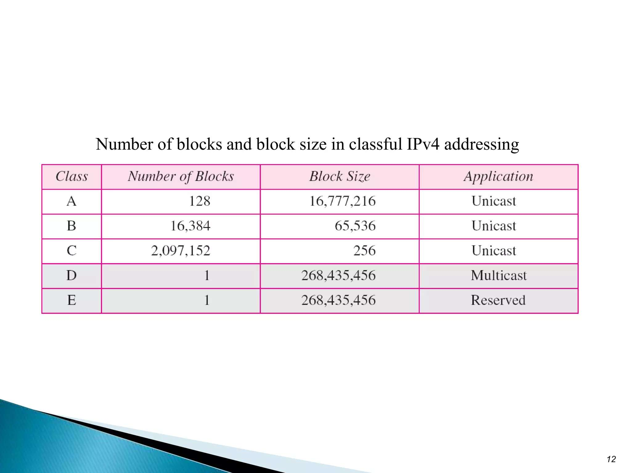

Slide 17
Public and private IP addressing
Public IP addresses: are assigned to devices that are directly connected to the Internet.
These addresses are globally unique and are routable over the Internet, meaning they can
be reached from any other device on the Internet.
Characteristics of Public IP Addresses
Unique: No two devices on the Internet can have the same public IP address at the same time.
Routable: Public IP addresses can be accessed from anywhere on the Internet.
Assigned by ISPs: Public IP addresses are typically assigned by Internet Service Providers (ISPs).
Examples of Public IP Addresses
8.8.8.8 (Google Public DNS)
172.217.0.0 (Google)

Slide 18
Private IP Addresses
Private IP addresses are used within private networks and are not routable over the Internet.
These addresses are reserved for internal use, allowing devices within a local network
(like a home or office) to communicate without needing a public address.

Slide 19
Characteristics of Private IP Addresses
Not Unique Globally: Multiple devices can use the same private IP address as long as they are on different networks.
Not Routable: Private IP addresses cannot be accessed directly from the Internet.
Defined Ranges: Specific ranges of IP addresses are designated for private use.

Slide 20
Cont….
Private IP Address Ranges
The following ranges are reserved for private IP addressing:
Class A: 10.0.0.0 to 10.255.255.255
Class B: 172.16.0.0 to 172.31.255.255
Class C: 192.168.0.0 to 192.168.255.255
Examples of Private IP Addresses
192.168.1.1
10.0.0.5
172.16.0.10

Slide 21
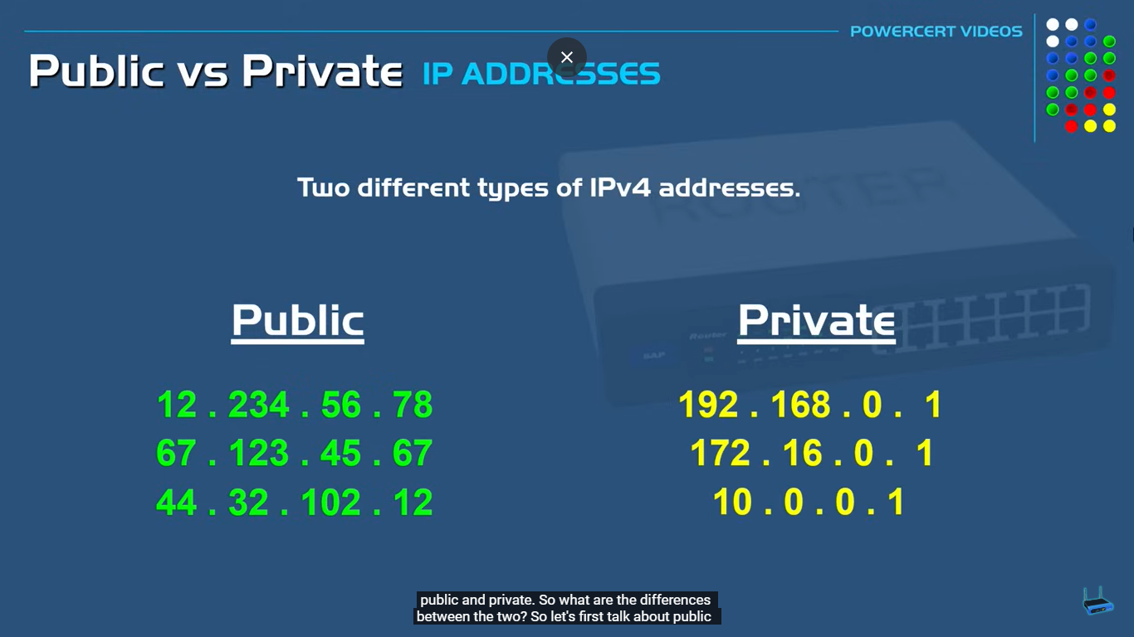

Slide 22
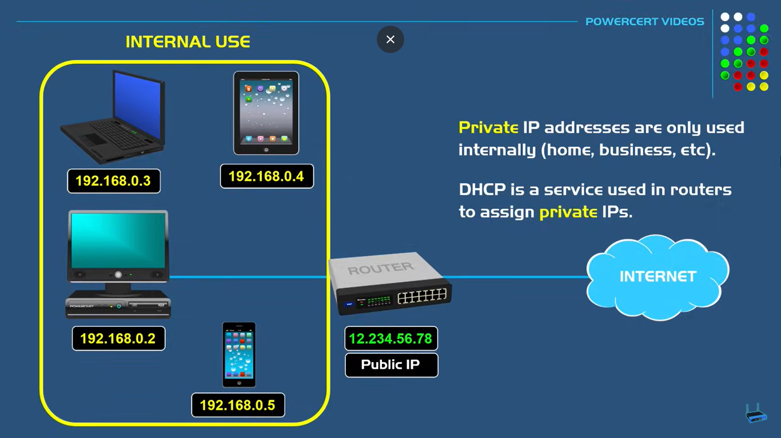

Slide 23
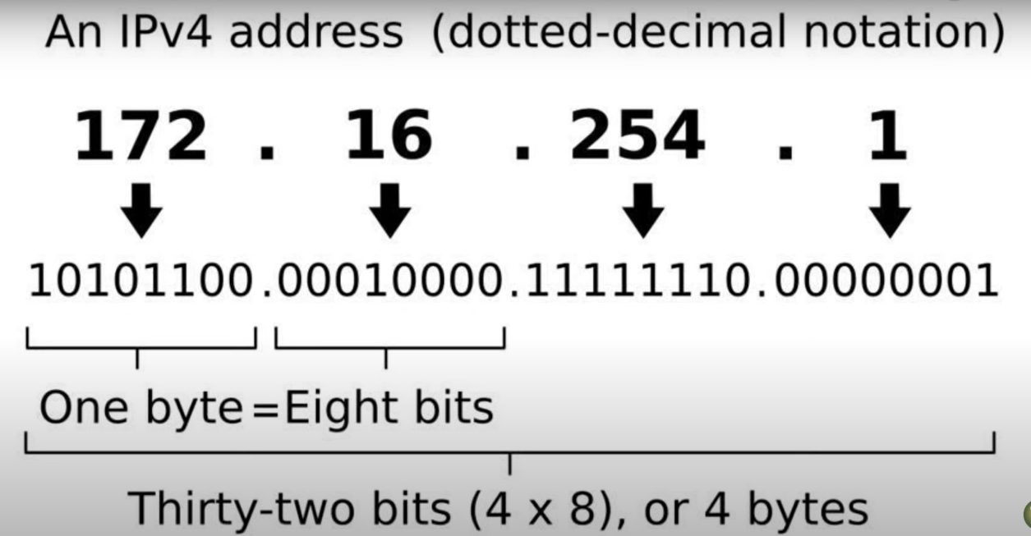

Slide 24
Network ID
The Network ID (or Network Address) identifies a specific network within a larger IP address space. It is used to route traffic to the correct network.
For IPv4, the Network ID is derived from the IP address and the subnet mask.
The subnet mask determines which portion of the IP address is the Network ID and which part is the Host ID.
Example: For an IP address of 192.168.1.10 with a subnet mask of 255.255.255.0,
the Network ID is
192.168.1.0. This indicates that all devices on this subnet share the same Network ID.

Slide 25
Broadcast ID
The Broadcast ID (or Broadcast Address) is used to send data packets to all devices on a specific subnet.
Any packet sent to the Broadcast ID will be received by all hosts in that network.
The Broadcast ID is typically the highest address in the subnet, where all the host bits are set to 1.
Example: Continuing with the previous example of the subnet 192.168.1.0/24, the Broadcast ID would be 192.168.1.255. This address is used to communicate with all devices in the 192.168.1.0 network.

Slide 26
END OF LECTURE ONE

Slide 27
Sub netting
Sub netting: is the process of dividing a larger IP network into smaller, more manageable sub-networks (subnets). This is useful for several reasons:
Improved Network Management: Smaller networks are easier to manage and troubleshoot.
Enhanced Security: Subnets can help isolate sensitive data and reduce the risk of unauthorized access.
Efficient Use of IP Addresses: Sub netting allows for better allocation of IP addresses based on organizational needs.

Slide 28
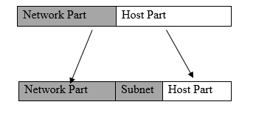

Slide 29
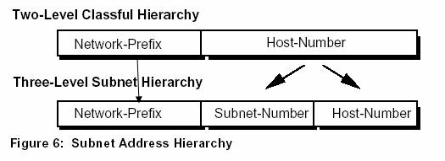

Slide 30
Cont …
How Subnetting Works
Subnet Mask: A subnet mask is used to determine which portion of an IP address identifies the network and which part identifies the host. It consists of a series of binary ones followed by zeros (e.g., 255.255.255.0 for a Class C network).
Example: For the IP address 192.168.1.1 and a subnet mask of 255.255.255.0, the network part is 192.168.1 and the host part is 1.

Slide 31
Cont …
CIDR Notation: Classless Inter-Domain Routing (CIDR) notation is a shorthand for expressing subnet masks. It represents the number of bits in the subnet mask (e.g., /24 for 255.255.255.0).
Variable Length Subnet Masking (VLSM): is a subnetting technique that allows network administrators to divide an IP address space into subnets of different sizes, rather than using a single fixed subnet mask for all subnets. This flexibility helps optimize the use of IP addresses and can lead to more efficient network designs.

Slide 32
Calculating Subnets: To create subnets, you can borrow bits from the host portion of an IP address. For example, with a /24 subnet mask, you can borrow 2 bits to create 4 subnets, each with 62 usable IP addresses.

Slide 33
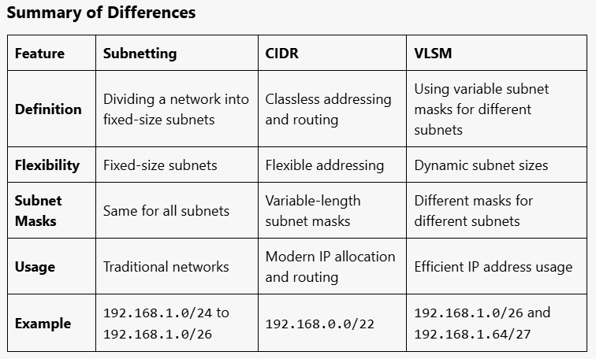

Slide 34
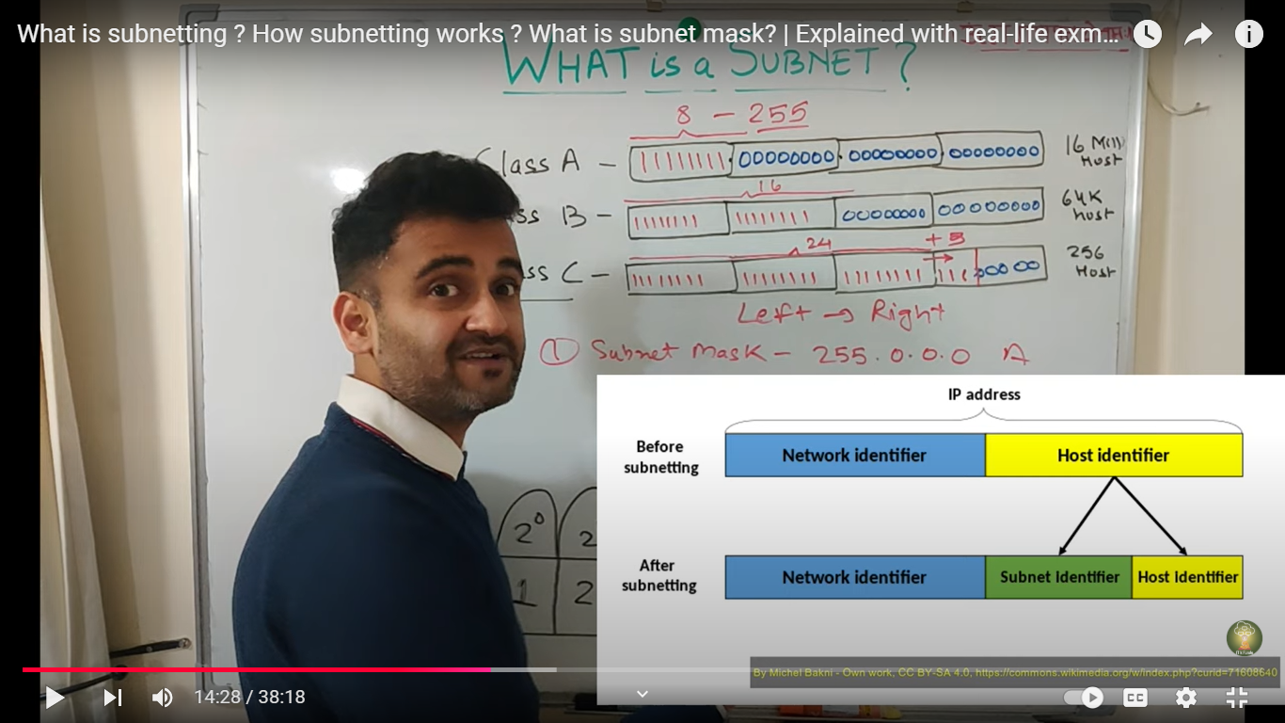

Slide 35
Example of Subnetting
Network: 192.168.1.0/24
Subnet Mask: 255.255.255.0
Subnets:
192.168.1.0/26 (Subnet 1: 192.168.1.1 to 192.168.1.62)
192.168.1.64/26 (Subnet 2: 192.168.1.65 to 192.168.1.126)
192.168.1.128/26 (Subnet 3: 192.168.1.129 to 192.168.1.190)
192.168.1.192/26 (Subnet 4: 192.168.1.193 to 192.168.1.254)

Slide 36
how to know the subnet range for the above network?
To determine the subnet range for a given network, you need to know the network address and the subnet mask. For example, let's use the network 192.168.1.0/24 and then see how to find the subnet ranges when subnetted further.
Identify the Network Address and Subnet Mask:
Network Address: 192.168.1.0
Subnet Mask: /24 (or 255.255.255.0)

Slide 37
Determine Usable Subnets: If you decide to subnet this network into smaller subnets, let’s say you want to create 4 subnets. This would require borrowing bits from the host portion.
Original Subnet Mask: /24 (255.255.255.0) allows 256 total addresses (0-255).
New Subnet Mask: To create 4 subnets, you can borrow 2 bits (since 2²=4 , leading to a new subnet mask of /26 (255.255.255.192).

Slide 38
Calculate the Subnet Ranges: With a /26 subnet mask, each subnet will contain 64 addresses (since 2(³²⁻²⁶)=2⁶=64 The subnets will be as follows:
Subnet 1:
Network Address: 192.168.1.0
Usable IP Range: 192.168.1.1 to 192.168.1.62
Broadcast Address: 192.168.1.63/set all 6 host portion bits to (111111)
Subnet 2:
Network Address: 192.168.1.64
Usable IP Range: 192.168.1.65 to 192.168.1.126
Broadcast Address: 192.168.1.127

Slide 39
Subnet 3:
Network Address: 192.168.1.128
Usable IP Range: 192.168.1.129 to 192.168.1.190
Broadcast Address: 192.168.1.191
Subnet 4:
Network Address: 192.168.1.192
Usable IP Range: 192.168.1.193 to 192.168.1.254
Broadcast Address: 192.168.1.255

Slide 40
Example 2(subnetting)
Given the IP address 172.16.0.0 with default subnet mask /16 that is 255.255.0.0.
Let’s say you want to create 8 subnets from this Class B network. To do this, you need to borrow bits from the host portion.
Calculate Bits to Borrow:
To create 8 subnets, you need 2^{n}=8, so n=2^{n} = 2³=8. This means you will borrow 3 bits from the host portion.
New Subnet Mask:
Original: /16
New: /19 (since 16+3=19)
New Subnet Mask: 255.255.224.0

Slide 41
Step 3: Calculate the Subnet Ranges
With a /19 subnet mask, each subnet will contain 2(³²⁻¹⁹)=2¹³=8,192 total addresses.
Subnet Ranges
The subnets can be calculated as follows:
Subnet 1:
Network Address: 172.16.0.0
Usable IP Range: 172.16.0.1 to 172.16.31.254
Broadcast Address: 172.16.31.255
Subnet 2:
Network Address: 172.16.32.0
Usable IP Range: 172.16.32.1 to 172.16.63.254
Broadcast Address: 172.16.63.255

Slide 42
Subnet 3:
Network Address: 172.16.64.0
Usable IP Range: 172.16.64.1 to 172.16.95.254
Broadcast Address: 172.16.95.255
Subnet 4:
Network Address: 172.16.96.0
Usable IP Range: 172.16.96.1 to 172.16.127.254
Broadcast Address: 172.16.127.255
Subnet 5:
Network Address: 172.16.128.0
Usable IP Range: 172.16.128.1 to 172.16.159.254
Broadcast Address: 172.16.159.255

Slide 43
Subnet 6:
Network Address: 172.16.160.0
Usable IP Range: 172.16.160.1 to 172.16.191.254
Broadcast Address: 172.16.191.255
Subnet 7:
Network Address: 172.16.192.0
Usable IP Range: 172.16.192.1 to 172.16.223.254
Broadcast Address: 172.16.223.255
Subnet 8:
Network Address: 172.16.224.0
Usable IP Range: 172.16.224.1 to 172.16.255.254
Broadcast Address: 172.16.255.255

Slide 44
VLSM
Example # given the network 192.168.1.0/24 (subnet mask 255.255.255.0)
consider the number of IP addresses required by each office:
Finance Office: 50 IP addresses
HRM Office: 30 IP addresses
Registrar Office: 120 IP addresses
Based on the above case allocate optimum IP addresses among the Finance, HRM, and Registrar offices using VLSM method.

Slide 45
Solution Sub netting Plan
Registrar Office (120 IPs): 2⁷=128(32-7=/25)
Subnet: 192.168.1.0/25
Subnet Mask: 255.255.255.128
Usable IP Range: 192.168.1.1 to 192.168.1.126
Broadcast Address: 192.168.1.127

Slide 46
Finance Office (50 IPs):2⁶(32-6)=/26
Subnet: 192.168.1.128/26
Subnet Mask: 255.255.255.192
Usable IP Range: 192.168.1.129 to 192.168.1.190
Broadcast Address: 192.168.1.191

Slide 47
HRM Office (30 IPs):
Subnet: 192.168.1.192/27
Subnet Mask: 255.255.255.224
Usable IP Range: 192.168.1.193 to 192.168.1.222
Broadcast Address: 192.168.1.223

Slide 48
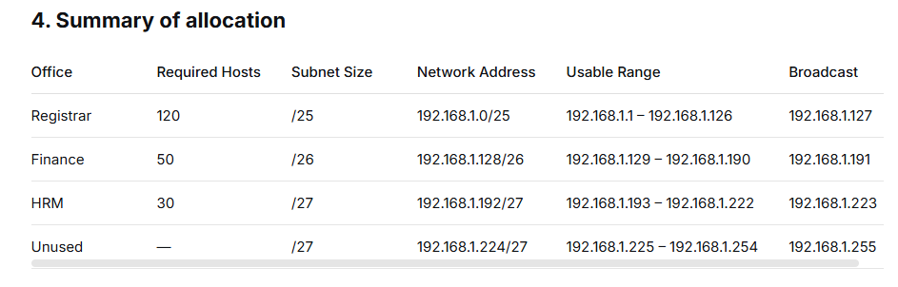

Slide 49
Exercises
#1 given the network address 192.168.0.0 and subnet mask 255.255.255.192
How many subnets are there?
How many hosts per subnet?
what are the list of subnets?
What is the broadcast address for each subnet?
What are the valid hosts?

Slide 50
Solution
#1. since 192 is 2 bits on(11000000) the answer would be 2²=4
#2. we have 6 host bits off (11000000)so 2⁶=64-2=62
#3. 256-192=64, we start at 0 and count in our block size our subnets will be 0, 64, 128, 192.
#4. the number right before the value of the next subnet is all host bits turned on and equals the broadcast address
#5. these are the numbers between the subnet and broadcast address

Slide 51
END OF CHAPTER FOUR
Online reference materials for IP addressing & subnetting
https://www.geeksforgeeks.org/introduction-to-subnetting/?ref=lbp
https://networklessons.com/subnetting
https://www.youtube.com/playlist?list=PLYtUYwNCm8ZMv6a7wBYDaedi_v29Wk9xk

